Slide 1

Charts and Graphs in R

Slide 2
Charts and Graphs supported
Pie chart
Bar chart
Box plots
Historams
Line graphs
Scatter plots

Slide 3
Pie charts
R Programming language has numerous libraries to create charts and graphs.
A pie-chart is a representation of values as slices of a circle with different colors.
The slices are labeled and the numbers corresponding to each slice is also represented in the chart.
In R the pie chart is created using the pie() function which takes positive numbers as a vector input.
The additional parameters are used to control labels, color, title etc.

Slide 4
Pie charts – Syntax
The basic syntax for creating a pie-chart using the R is −
pie(x, labels, radius, main, col, clockwise)
Following is the description of the parameters used −
  x is a vector containing the numeric values used in the pie chart.
  labels is used to give description to the slices.
  radius indicates the radius of the circle of the pie chart.(value between −1 and +1).
  main indicates the title of the chart.
  col indicates the color palette.
  clockwise is a logical value indicating if the slices are drawn clockwise or anti clockwise.

Slide 5
Pie charts – Example
# Create data for the graph. x <- c(21, 62, 10, 53)
labels <- c("London", "New York", "Singapore", "Mumbai")
# Plot the chart. pie(x,labels)
# Save the file. dev.off()

Slide 6
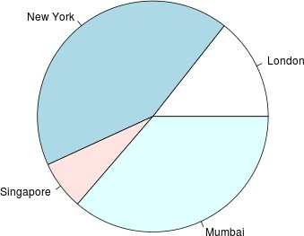
Pie charts – Example

Slide 7
Pie chart example with colors
# Create data for the graph. x <- c(21, 62, 10, 53)
labels <- c("Pune", "Nashik", "Aurangabad", "Mumbai")
# Give the chart file a name. png(file = "city_title_colours.png")
# Plot the chart with title and rainbow color pallet.
pie(x, labels, main = "City pie chart", col = rainbow(length(x)))
# Save the file. dev.off()

Slide 8
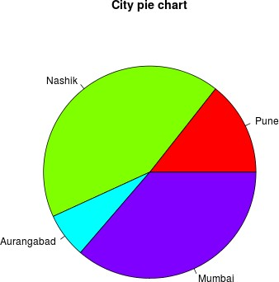
Pie chart example with colors

Slide 9
Pie chart with colors and labels
# Create data for the graph. x <- c(21, 62, 10,53)
labels <- c("London","New York","Singapore","Mumbai")
piepercent<- round(100*x/sum(x), 1) png(file = "city_percentage_legends.png")
# Plot the chart.
pie(x, labels = piepercent, main = "City pie chart",col = rainbow(length(x)))
legend("topright", c("Pune","Nashik","Aurangabad","Mumbai"), cex = 0.8, fill = rainbow(length(x)))
# Save the file. dev.off()

Slide 10
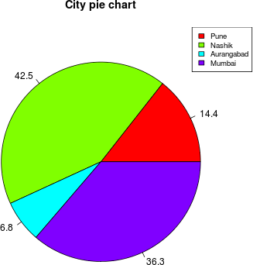
Pie chart with colors and labels

Slide 11
3D Pie Chart
# Get the library. library(plotrix)
# Create data for the graph. x <- c(21, 62, 10,53)
lbl <- c("Nashik","Aurangabad","Navi Mumbai","Nagpur")
png(file = "3d_pie_chart.png") # Plot the chart.
pie3D(x,labels = lbl,explode = 0.1, main = "Pie Chart of Countries ")
dev.off()

Slide 12
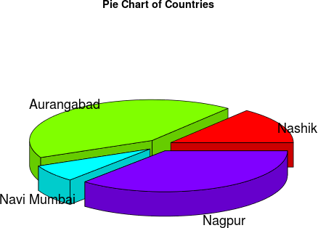
3D Pie Chart

Slide 13
Bar charts
A bar chart represents data in rectangular bars with length of the bar proportional to the value of the variable.
R uses the function barplot() to create bar charts.
R can draw both vertical and horizontal bars in the bar chart.
In bar chart each of the bars can be given different colors.

Slide 14
Bar charts – Syntax
The basic syntax to create a bar-chart in R is −
barplot(H, xlab, ylab, main, names.arg, col)
Following is the description of the parameters used −
  H is a vector or matrix containing numeric values used in bar chart.
  xlab is the label for x axis.
  ylab is the label for y axis.
  main is the title of the bar chart.
  names.arg is a vector of names appearing under each bar.
  col is used to give colors to the bars in the graph.

Slide 15
Bar charts – Example
# Create the data for the chart. H <- c(7,12,28,3,41)
# Give the chart file a name. png(file = "barchart.png")
# Plot the bar chart. barplot(H)
# Save the file. dev.off()

Slide 16
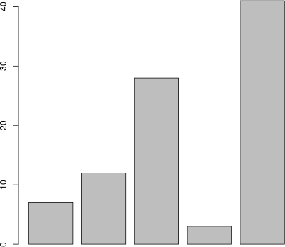
Bar charts – Example

Slide 17
Bar chart with attributes
# Create the data for the chart. H <- c(7,12,28,3,41)
M <- c("Mar","Apr","May","Jun","Jul")
# Give the chart file a name.
png(file = "barchart_months_revenue.png")
# Plot the bar chart.
barplot(H,names.arg = M,xlab = "Month",ylab = "Revenue",col = "blue", main = "Revenue chart",border
= "red")
dev.off()

Slide 18
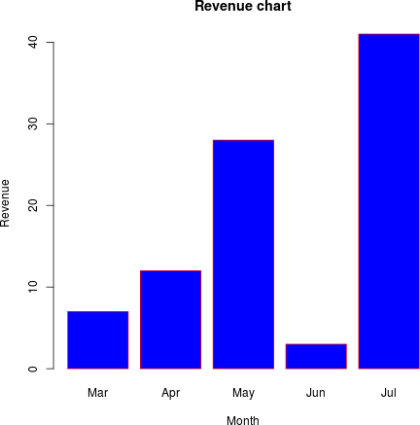
Bar chart with attributes

Slide 19
Bar chart – Stacked
colors <- c("green","orange","brown") months <- c("Mar","Apr","May","Jun","Jul") regions <- c("East","West","North")
Values <- matrix(c(2,9,3,11,9,4,8,7,3,12,5,2,8,10,11),nrow =
3,ncol = 5,byrow = TRUE)
png(file = "barchart_stacked.png")
barplot(Values,main = "total revenue",names.arg = months,xlab = "month",ylab = "revenue", col = colors)
legend("topleft", regions, cex = 1.3, fill = colors) dev.off()

Slide 20
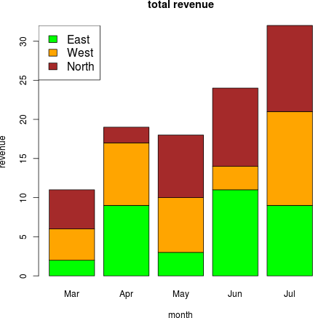
Bar chart – Stacked

Slide 21
Boxplot
Boxplots are a measure of how well distributed is the data in a data set.
It divides the data set into three quartiles. This graph represents the minimum, maximum, median, first quartile and third quartile in the data set.
It is also useful in comparing the distribution of data across data sets by drawing boxplots for each of them.
Boxplots are created in R by using the boxplot() function.

Slide 22
Boxplot – Syntax
The basic syntax to create a boxplot in R is −
boxplot(x, data, notch, varwidth, names, main)
Following is the description of the parameters used −
  x is a vector or a formula
  data is the data frame.
  notch is a logical value. Set as TRUE to draw a notch.
  varwidth is a logical value. Set as true to draw width of the box proportionate to the sample size.
  names are the group labels which will be printed under each boxplot.
  main is used to give a title to the graph.

Slide 23
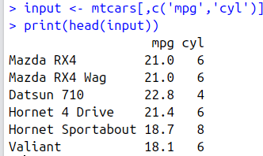
Boxplot – Example
We use the data set "mtcars" available in the R environment to create a basic boxplot. Let's look at the columns "mpg" and "cyl" in mtcars.
input <- mtcars[,c('mpg','cyl')] print(head(input))

Slide 24
Boxplot – Example
# Give the chart file a name. png(file = "boxplot.png")
# Plot the chart.
boxplot(mpg ~ cyl, data = mtcars, xlab = "Number of Cylinders", ylab = "Miles Per Gallon", main = "Mileage Data")
# Save the file. dev.off()

Slide 25
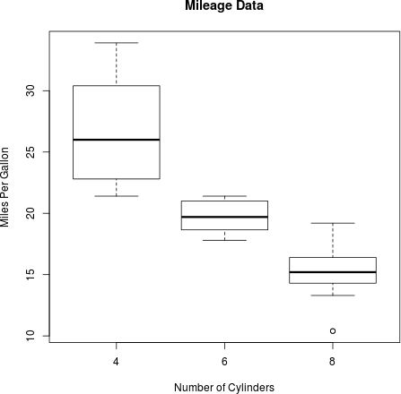
Boxplot – Example

Slide 26
Boxplot with notch
png(file = "boxplot_with_notch.png")
# Plot the chart.
boxplot(mpg ~ cyl, data = mtcars, xlab = "Number of Cylinders", ylab = "Miles Per Gallon", main = "Mileage Data",
notch = TRUE, varwidth = TRUE,
col = c("green","yellow","purple"),
names = c("High","Medium","Low")
)
dev.off()

Slide 27
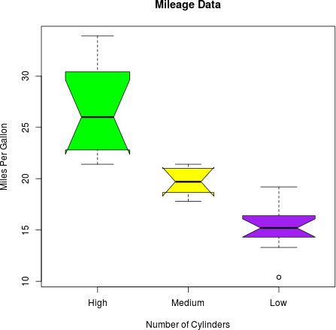
Boxplot with notch

Slide 28
Histogram
A histogram represents the frequencies of values of a variable bucketed into ranges.
Histogram is similar to bar chart but the difference is it groups the values into continuous ranges.
Each bar in histogram represents the height of the number of values present in that range.
R creates histogram using hist() function. This function takes a vector as an input and uses some more parameters to plot histograms.

Slide 29
Histogram – Syntax
The basic syntax for creating a histogram using R is −
hist(v,main,xlab,xlim,ylim,breaks,col,border)
Following is the description of the parameters used −
v is a vector containing numeric values used in histogram. main indicates title of the chart.
col is used to set color of the bars.
border is used to set border color of each bar. xlab is used to give description of x-axis.
xlim is used to specify the range of values on the x-axis.
ylim is used to specify the range of values on the y-axis. breaks is used to mention the width of each bar.

Slide 30
Histogram – Example
# Create data for the graph.
v <- c(9,13,21,8,36,22,12,41,31,33,19)
# Give the chart file a name. png(file = "histogram.png")
# Create the histogram.
hist(v,xlab = "Weight",col = "yellow",border = "blue")
# Save the file. dev.off()

Slide 31
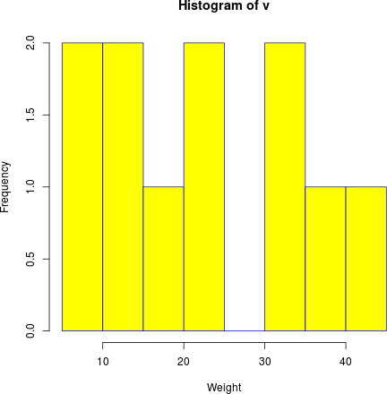
Histogram – Example

Slide 32
Histogram – Example
# Create data for the graph.
v <- c(9,13,21,8,36,22,12,41,31,33,19)
# Give the chart file a name. png(file = "histogram_lim_breaks.png")
# Create the histogram.
hist(v,xlab = "Weight",col = "green",border = "red", xlim = c(0,40), ylim = c(0,5), breaks = 5)
dev.off()

Slide 33
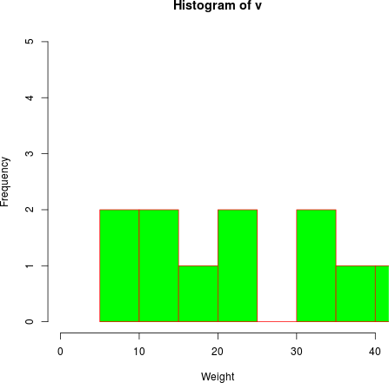
Histogram – Example

Slide 34
Line graph
A line chart is a graph that connects a series of points by drawing line segments between them.
These points are ordered in one of their coordinate (usually the x-coordinate) value.
Line charts are usually used in identifying the trends in data.
The plot() function in R is used to create the line graph.

Slide 35
Line graph – Syntax
The basic syntax to create a line chart in R is −
plot(v,type,col,xlab,ylab)
Following is the description of the parameters used −
  v is a vector containing the numeric values.
  type takes the value "p" to draw only the points, "i" to draw only the lines and "o" to draw both points and lines.
  xlab is the label for x axis.
  ylab is the label for y axis.
  main is the Title of the chart.
  col is used to give colors to both the points and lines.

Slide 36
Line graph – Example
# Create the data for the chart. v <- c(7,12,28,3,41)
# Give the chart file a name. png(file = "line_chart.png")
# Plot the line graph. plot(v,type = "o")
# Save the file. dev.off()

Slide 37
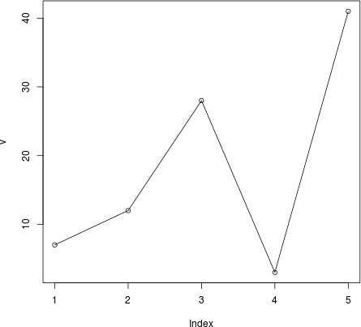
Line graph – Example

Slide 38
Line graph – example.
# Create the data for the chart. v <- c(7,12,28,3,41)
# Give the chart file a name.
png(file = "line_chart_label_colored.png")
# Plot the bar chart.
plot(v,type = "o", col = "red", xlab = "Month", ylab = "Rain fall", main = "Rain fall chart")
# Save the file. dev.off()

Slide 39
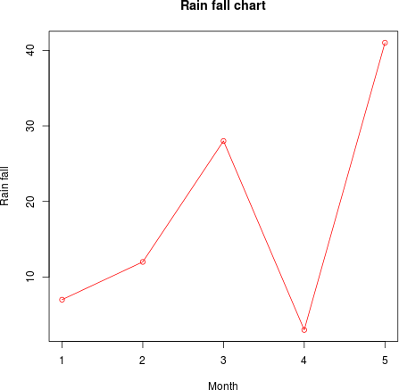
Line graph – example.

Slide 40
Multiple lines in chart
# Create the data for the chart. v <- c(7,12,28,3,41)
t <- c(14,7,6,19,3)
# Give the chart file a name. png(file = "line_chart_2_lines.png")
# Plot the bar chart.
plot(v,type = "o",col = "red", xlab = "Month", ylab = "Rain fall", main = "Rain fall chart")
lines(t, type = "o", col = "blue") dev.off()

Slide 41
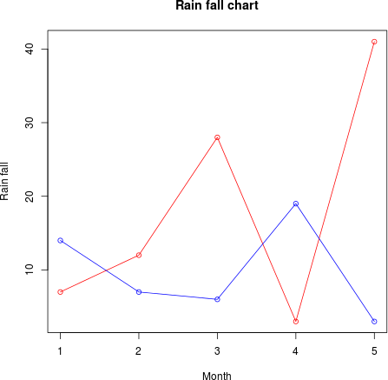
Multiple lines in chart

Slide 42
ScatterPlot
Scatterplots show many points plotted in the Cartesian plane.
Each point represents the values of two variables.
One variable is chosen in the horizontal axis and another in the vertical axis.
The simple scatterplot is created using the plot() function.

Slide 43
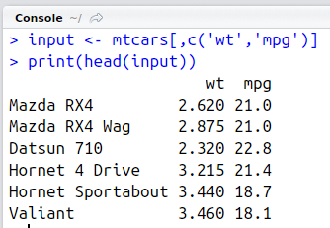
ScatterPlot – Example
We use the data set "mtcars" available in the R environment to create a basic scatterplot.
Let's use the columns "wt" and "mpg" in mtcars.
input <- mtcars[,c('wt','mpg')] print(head(input))

Slide 44
ScatterPlot – Example
# Get the input values.
input <- mtcars[,c('wt','mpg')]
png(file = "scatterplot.png")
# Plot the chart for cars with weight between 2.5 to 5 and mileage between 15 and 30.
plot(x = input$wt,y = input$mpg,
xlab ylab | = = | "Weight", "Milage",
xlim | = | c(2.5,5),
ylim | = | c(15,30),
main | = | "Weight vs Milage"
)
dev.off()

Slide 45
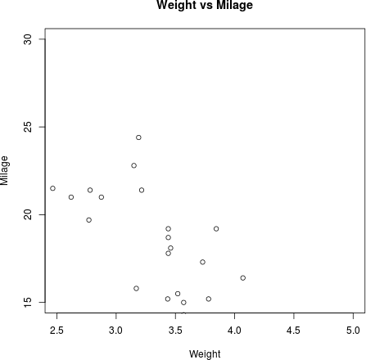
ScatterPlot – Example

Slide 46
Scatter Plot matrices
When we have more than two variables and we want to find the correlation between one variable versus the remaining ones we use scatterplot matrix.
We use pairs() function to create matrices of scatterplots.
  Syntax:
pairs(formula, data)
  Following is the description of the parameters used −
formula represents the series of variables used in pairs.
data represents the data set from which the variables will be taken.

Slide 47
Scatter Plot matrices – Example
# Give the chart file a name.
png(file = "scatterplot_matrices.png")
# Plot the matrices between 4 variables giving 12 plots.
# One variable with 3 others and total 4 variables.
pairs(~wt+mpg+disp+cyl,data = mtcars,main = "Scatterplot Matrix")
dev.off()

Slide 48
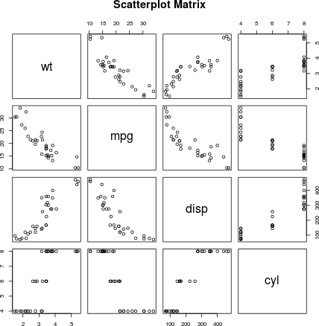
Scatter Plot matrices – Example

Slide 49
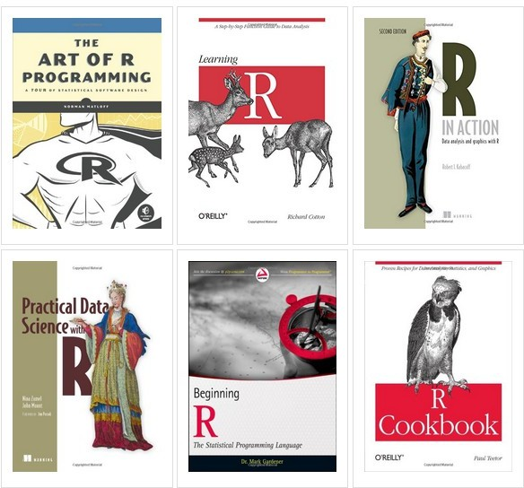
Useful resources

